Slide 1
Simple Machines: The Lever
Year 7 Science

Slide 2
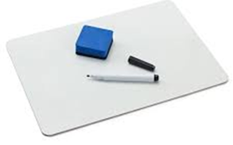
Review
Draw a type of inclined plane. | Convert 800N to kg.
Explain why an inclined plane is a machine. | Explain mechanical advantage.

Slide 3
Learning Intentions
Investigating a simple machine such as lever or pulley system

Slide 4
Success criteria
Explain that a simple machine works by reducing the force but increasing the distance.
Explain how levers work.
Classify levers as 1st, 2nd or 3rd class.

Slide 5
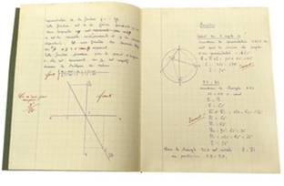
Simple Machines
(continue notes from yesterday!)
Levers are a type of simple machine because they produce a mechanical advantage: less force – more distance.
There are three types of levers:

Slide 6
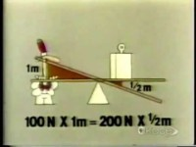

Slide 7
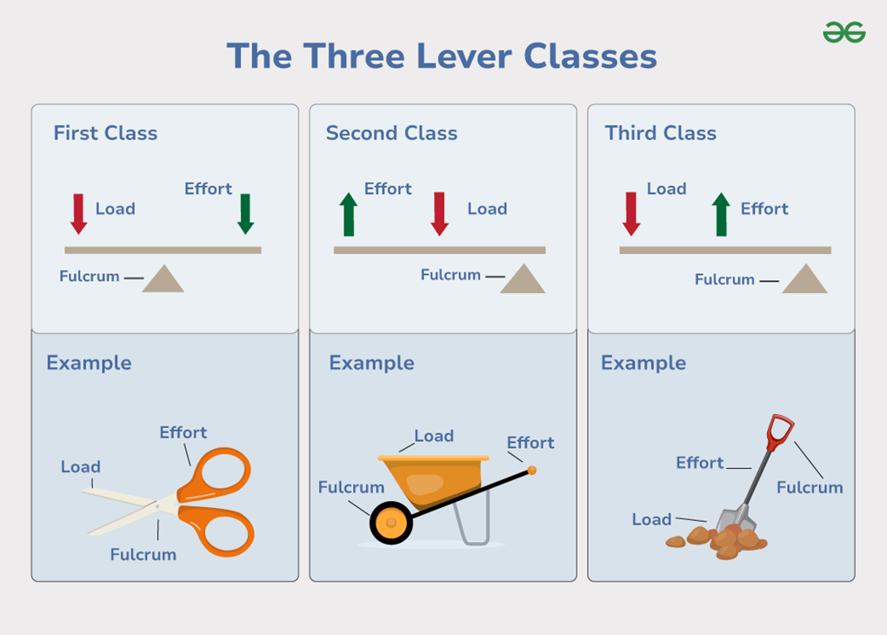

Slide 17
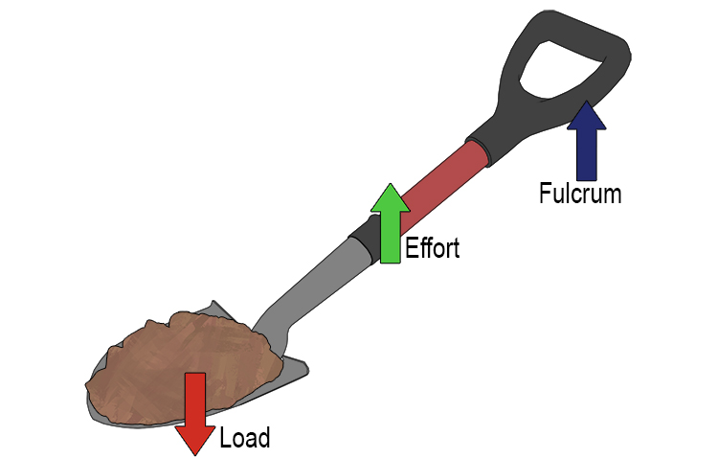
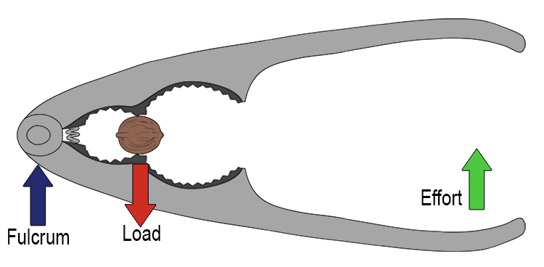
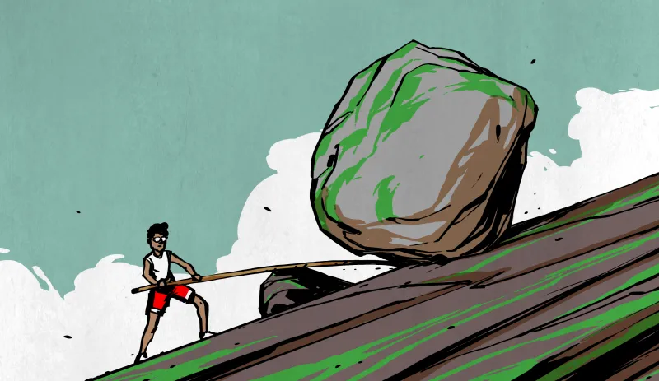
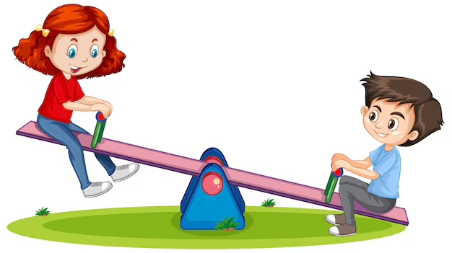
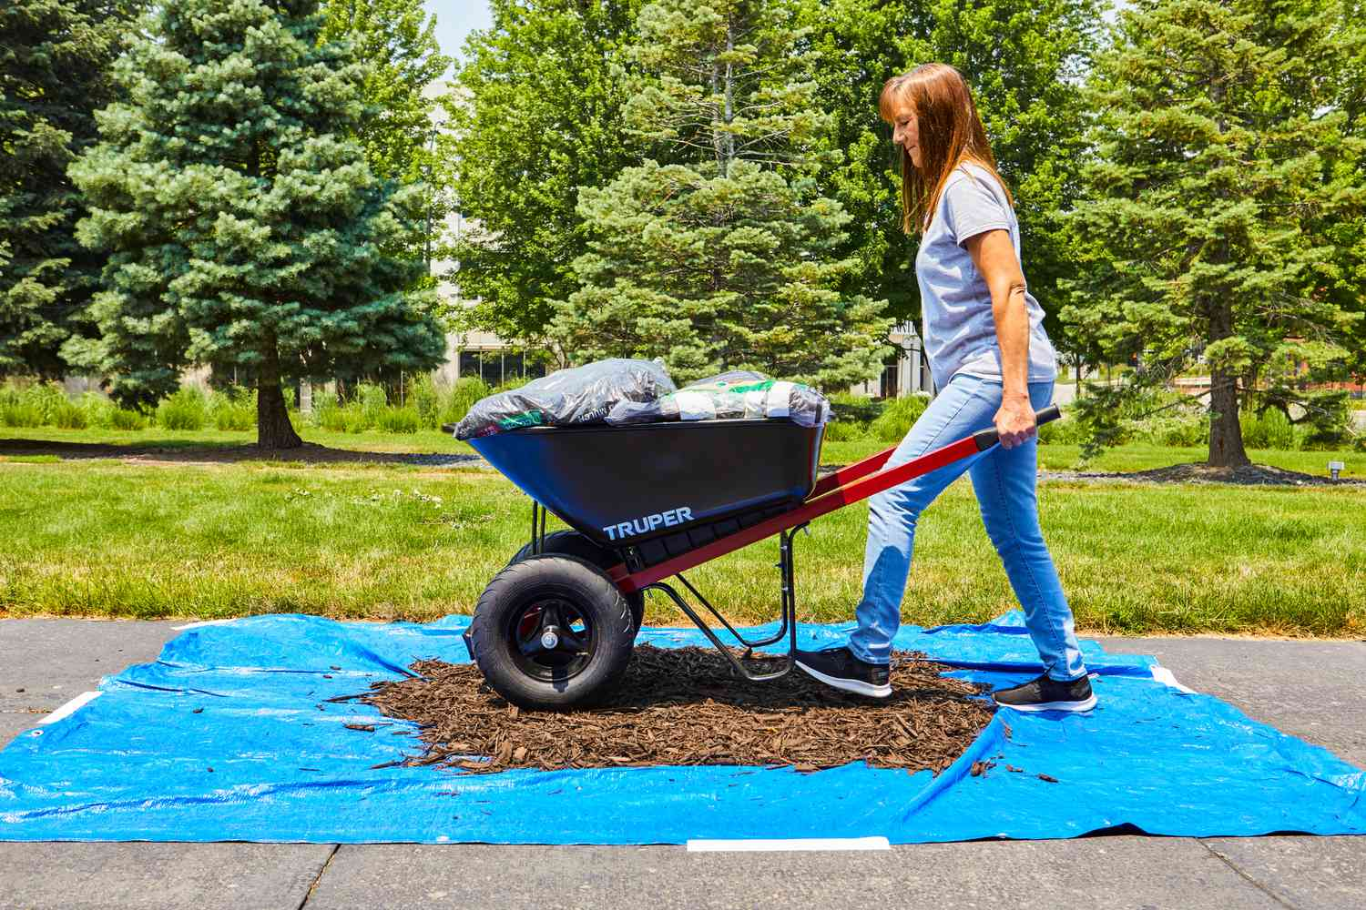
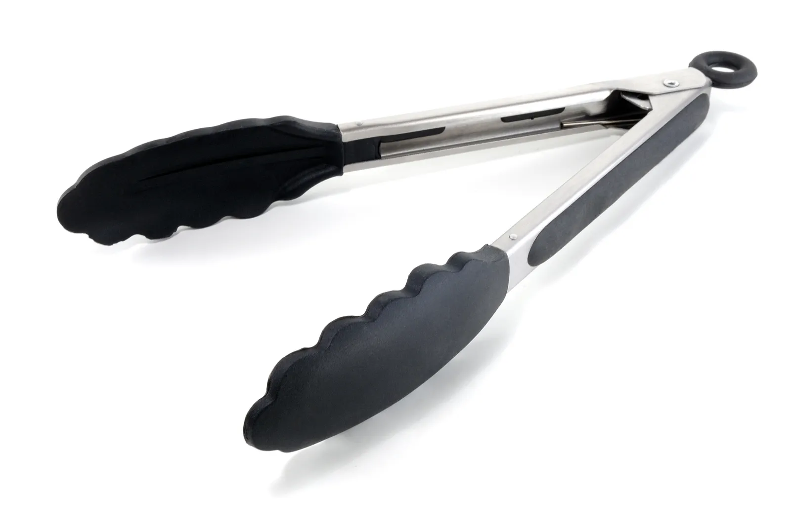
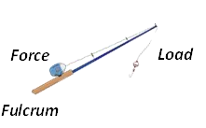
First, second or third class?

Slide 18
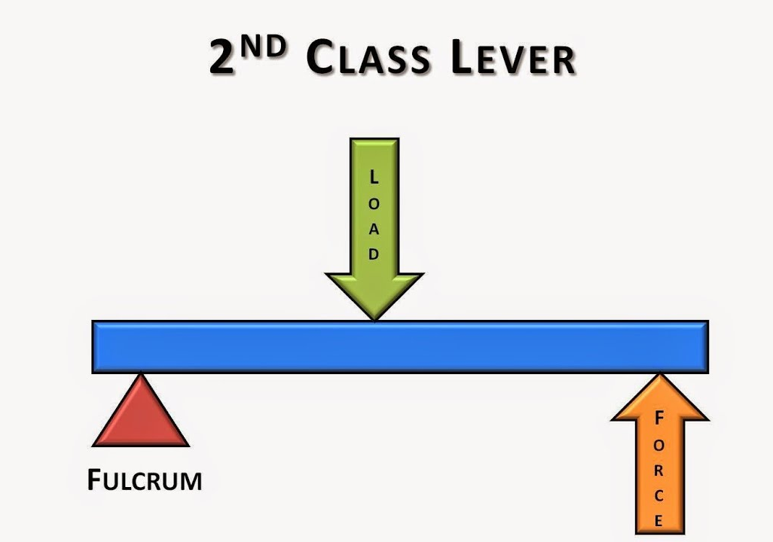
Investigation: Inclined Planes 5%
How does changing the length of the lever create a force advantage?
What will you change?
What will you measure?
What will you keep the same?

Slide 19
Success criteria
Explain that a simple machine works by reducing the force but increasing the distance.
Explain how levers work.
Classify levers as 1st, 2nd or 3rd class.

